Slide 1

Truth-in-Taxation and 2022 Budget Presentation
December 6th, 2021
City Council Meeting

Slide 2
Truth in Taxation
Required by MN Statute 275.065
Purpose
Discussion of Levy for Taxes Payable in 2022
Discussion of 2022 Budget
Public Input
Notes:
Purpose is not to address market valuations
Market Value Determination is donethrough Henn Cty
Board of Equalization meeting.

Slide 3
Budget Process
Council Establishes 2022 Budget Goals and Objectives
Staff Prepares Proposed Budgets
Budget Discussions at Council Work Sessions
Preliminary Tax Levy & Budget
Approved on September 16, 2019
Continue Budget Review
Final Budget Adoption
Truth in Taxation
Public Input

Slide 4

Property Taxes Account for 53% of the City’s 2022 Budgeted General Fund Revenue
Notes:
Other Revenues consists of: Penalties, Assessment Search Fees, Miscellaneous Revenues, Refunds and Reimbursements

Slide 5
General Fund Budget - Revenues by Source
Notes:
Revenues are projected to increase 5.5% over 2021. The increase in licenses and permits is largely due to an increased number of building permits sold and increase in the building permit rates. Transfers from Other Funds is an additional $100,000. This is the $100,000 that is usually transferred to the park improvement fund. It is being allocated to the General Fund this year to cover the Assistant Public Works Director position and also to pay for Lifeguards.

Slide 6
What Does the City Levy Pay for?
Notes:
Public Safety 44%, General Government 29%, Culture and Recreation 15%, Public Works 12%

Slide 7
General Fund Budget - Expenditures by Function
Notes:
Public Safety consists of Police, Fire, and Building Inspections.
General Government consists of City Council, City Manager/Clerk, Elections, Finance, Planning and Zoning, and City Administration (City Hall).
Public Works consists of Engineering and Streets.
Culture and Recreation consists of Heritage Preservation, Park Maintenance, Recreation Programs, and Cemetery.

Slide 8
General Fund Expenditures
Notes:
Elections only happen in even numbered years so there is little to not budget in odd numbered years for election expenses. There was also a change in the way the Finance and City Manager/Clerk were budgeted in 2021 which was not consistent with prior years. Going forward those departments will be budgeted as previous years. Park Maintenance increase is due to a new Assistant Public Works Director position allocated to parks. Recreation Programs expenses is for Lifeguards. Both the Assistant Public Works and Lifeguards expenses are being covered by the additional $100,000 transfer from the docks fund to the general fund.

Slide 9

Where else does your property tax dollar go?
40%
Minnetonka
School District
33%
Hennepin
County
21%
City of
Excelsior
4%
Other
2% Met Council

Slide 10
What do your property tax dollars pay for?

Slide 11
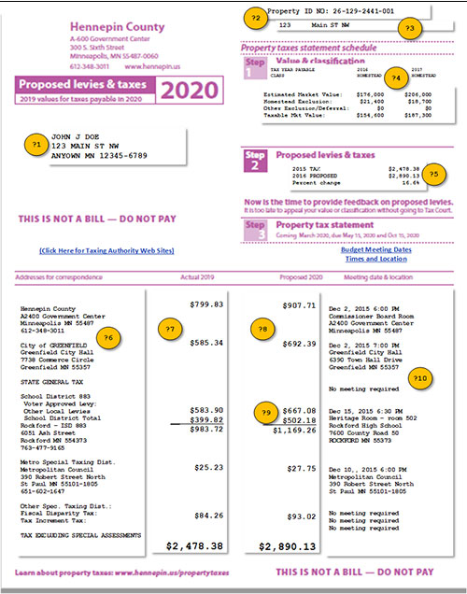
County
City
School
Special Dist.
Other Dist.
Approximately 21% of your property tax dollars pay for City services.
Notes:
There are a number of different taxing entities on your tax statement in addition to the City of Excelsior. Hennepin County, School District, and Special Taxing Districts and if your property has any special assessments those are listed on the statement as well.

Slide 12

City of Excelsior Property Taxes
• City property taxes are determined by the City’s Levy.
• Excelsior’s levy consists of a General Levy, a Capital Improvement Levy (new in 2020) and Debt Service Levies to service bonds issued for the street and utility improvement projects.
• Hennepin County is responsible for valuations
  Valuation Notices sent in March
  City holds Open Book Meeting in April
  ~ Opportunity to contest valuation

Slide 13
Components of City’s Levy
Notes:
Overall increase of 9% from 2021

Slide 14
Proposed Levy Increase for 2022
Total Proposed Levy - $2,188,937
$180,738 more than 2021 levy
Increase is primarily related to increased debt service payments and additional staff
Notes:
2019—$118,648 or 8.2% Increase, 2020--$207,852 or 13.3% increase, 2021--$234,108 or 13.2% increase, 2022--$180,738 or 9.0% increase

Slide 15
Estimated Market Value Trendline
2022 Proposed Market Value – City of Excelsior $642,372,600
2021 Estimated Market Value Median Single Family Residential - $562,000
Notes:
2019-$37,494,662 increase; 2020-$46,992,600 increase; 2021-$45,088,100 increase; 2022-$33,555,600 increase

Slide 16
Excelsior Tax Rate
Notes:
The dotted line represents the levy trending downward

Slide 17
Increase in Tax Capacity to Increase in City Tax Levy

Slide 18
2021 Hennepin County Tax Rates

Slide 19
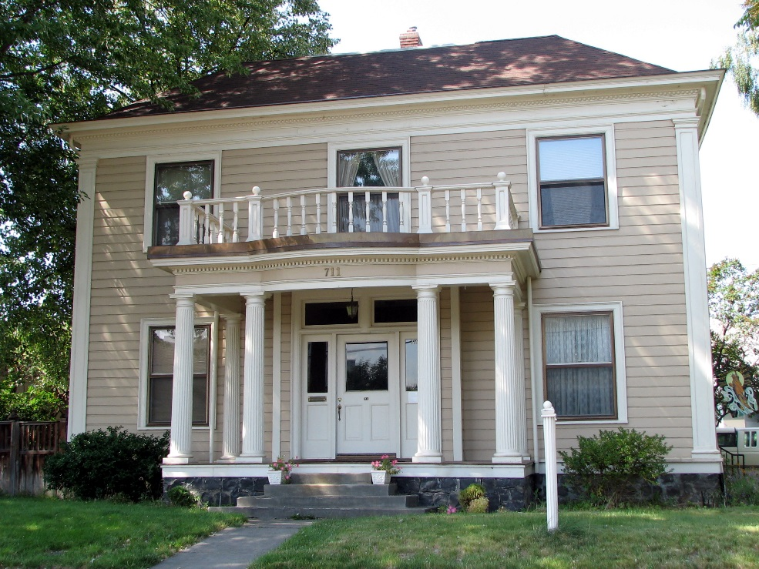
Residential Examples
This Photo by Unknown Author is licensed under CC BY-SA
Notes:
That amount is the actual taxes based on Hennepin County’s tax calculation formula. The first $500,000 is taxed at 1% of the Net Tax Capacity times the tax rate. Any amount over $500,000 is taxed at 1.25% of the property value. The Homestead Credit phases out to zero at $413,775.

Slide 20
2022 Proposed Utility Rate Increases
UTILITY RATES
(assumes “average” residential water use of 15,000 gallons per quarter)
Notes:
Only the water fund rates are increasing for 2022. The annual impact to an average customer will be $104.76.

Slide 21
Next Steps
City Council to Accept Public Input
Consideration of Resolutions
Setting the Final 2021 Levy for Payable 2022
Adopting the 2022 Budget

Slide 22
The Approved 2022 budget will be available on the City’s website.
Hard copies may be obtained at City Hall during regular business hours.
http://www.excelsiormn.org
Excelsior City Hall
339 Third Street
Excelsior, MN 55331

Slide 23
Any questions or comments?
Contact Info:
Jenny Palmer, Finance Director
jpalmer@excelsiormn.org
(952) 653-3677 (direct)

